Slide 1

CYBERFORENSICS T20 SERIES
TEAM NAME: ALPHA
NIVETHA S 20MIS0347
KAUSTUBH MATHUR 20MIS0225
THILAK RAJ C 20MIS0401
THULASI MADHAN 20MIS0415
MAHALAKSHMI V 20MIS0263

Slide 2

PROBLEM STATEMENT
Identifying/profiling information about Dark web markets selling Leaked Data

Slide 3

OUR SOLUTION

Slide 4

OBJECTIVES

Slide 5
Monitor
Monitor Dark Web Markets
Collect
Collect Data
Identify
Identify Patterns
Provide
Provide Alerts
Enhance
Enhance decision making

Slide 6
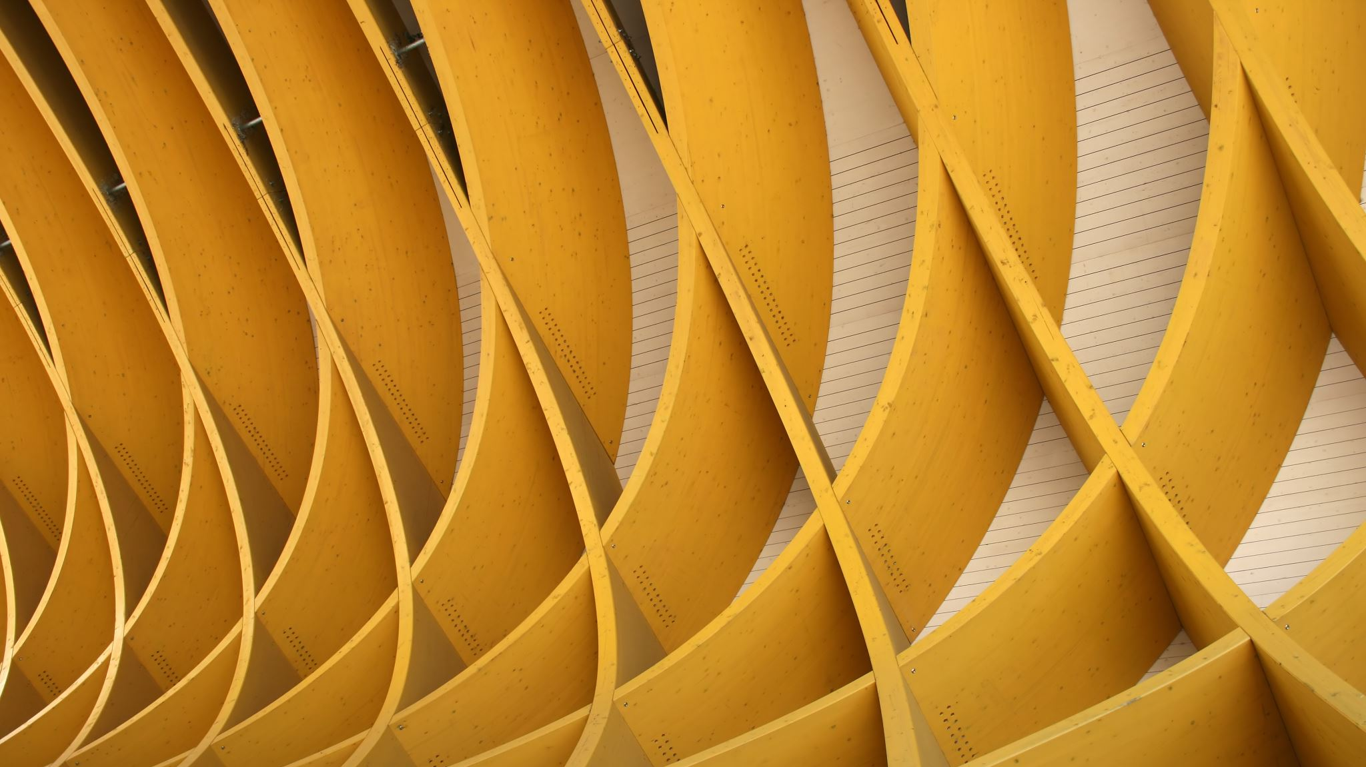
ARCHITECTURE OF THE CRAWLER DEVELOPED

Slide 7
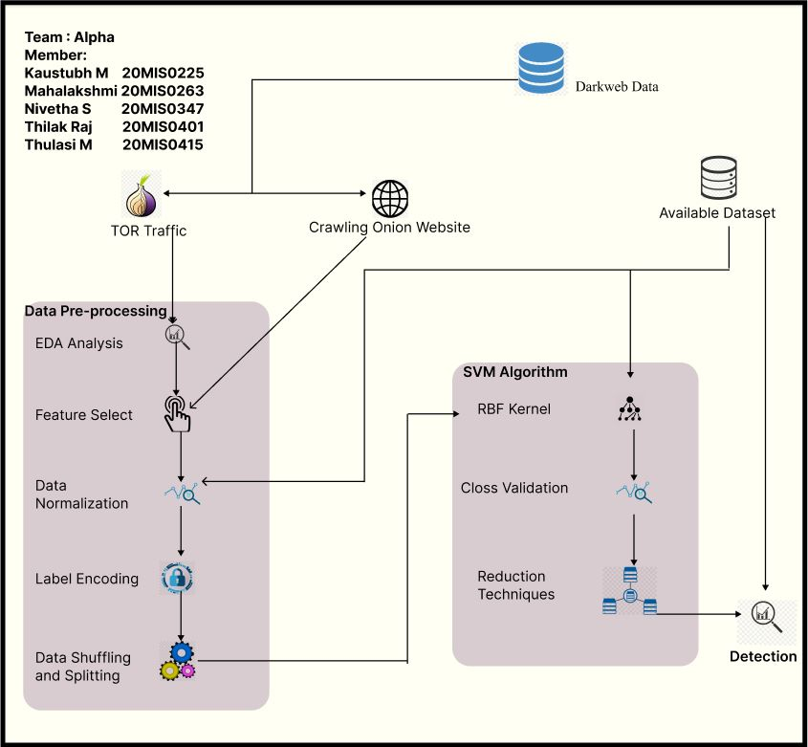
LOW LEVEL DESIGN

Slide 8
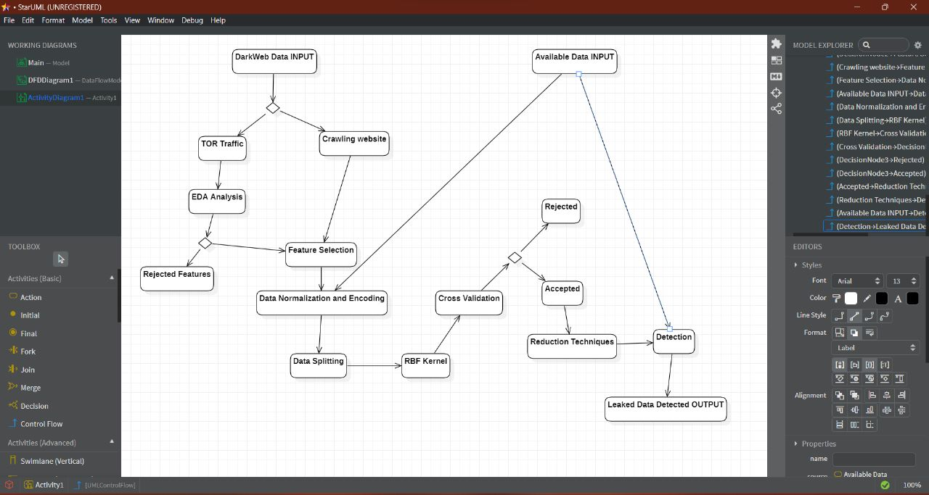
HIGH LEVEL DESIGN

Slide 9

OUTPUT

Slide 10
Typically, it generates a list of URLs or web addresses of websites, forums, or marketplaces on the dark web and ranks it according to the relevance of content.
The frequency of the spider-crawling websites depends on the search engine’s discretion.
This list can include information such as the website's name, description, and the type of content it contains.
In some cases, the crawler may also capture metadata about the web pages, such as their title, keywords, and other information.

Slide 11
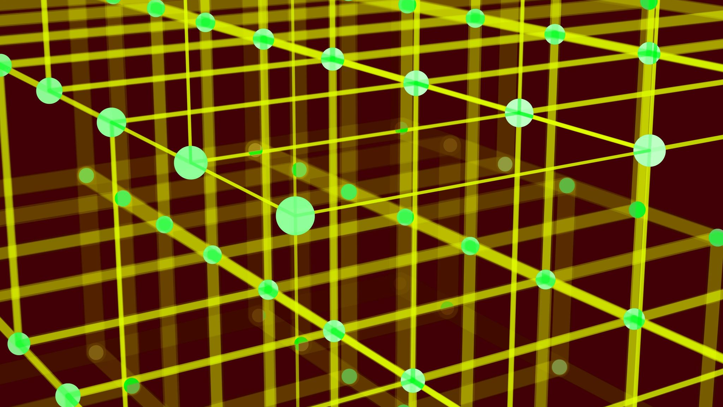
OUTCOME

Slide 12
In the field of monitoring the dark web, web crawlers also play an essential role.
The term "dark web" refers to a portion of the internet that is not searched by conventional search engines and that is only accessible through the use of specialized software such as the TOR network.
Traditional search engines are unable to access the dark web.
The "dark web" is frequently used for illegal endeavors, including the purchase and sale of illicit substances, firearms, and stolen personal information.
Web crawlers can be used to monitor the dark web and collect intelligence on illegal activity.
This can help law enforcement find the people who did something wrong so they can bring them to justice.

Slide 13
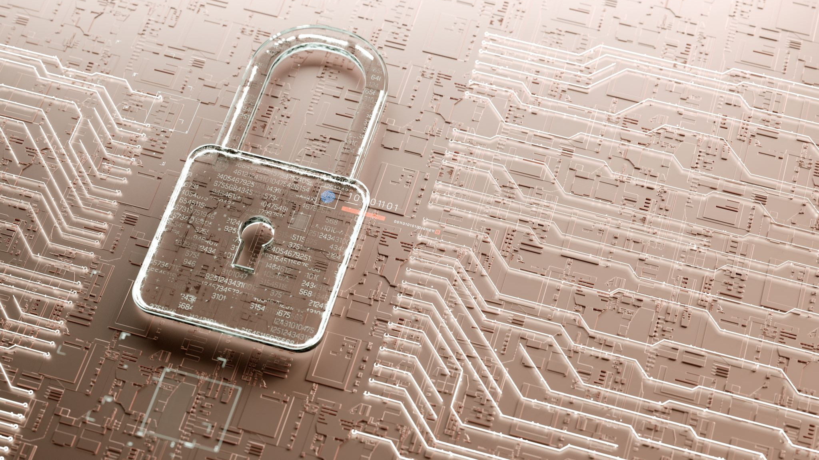
SIGNIFICANCE TO THE SECURITY INDUSTRY

Slide 14
Detection of criminal activities
Prevention of cybercrime
Mitigation of risk
Enhancement of investigations
Improvement of situational awareness

Slide 15

SIGNIFICANCE TO THE SOCIETY

Slide 16
Protection of individuals and organizations
Reduction of illegal activities
Enhancement of law enforcement efforts
Improvement of trust in online transactions

Slide 17

RESULTS

Slide 19

FUTURE RESEARCH

Slide 20
We can try to implement a real-time scenario for criminal activity tracking using an artificial neural network in the future.

Slide 21

THANK YOU

